Slide 1

iOS Dev Scout Singapore, October 2018
Notes:
Hello everyone. Welcome to iOS dev scout October 2018.
For us here engineering, our mission is to bring the best experience to our customers.
But because the resource we have is limited, hence whenever we want to implement anything, we always need to keep balance between the cost and the profit it can bring to us.
So today in my presentation, I would like to introduce to you an option that doesn’t take you much effort
But can help your service reach out a lot of more users.
And more users means more profitable
Before we start, I wanna briefly introduce about myself.

Slide 2

Thanh
Software Engineer
Rakuten Viki
linkedin.com/in/thanhturin/
thanhturin@gmail.com
Notes:
My name is Thanh
I’m currently an iOS developer at Rakuten Viki
Thanks Lizzie for her recent introduction about Viki.
[Or Viki is an Asian drama streaming platform]
You can find more information about me by visit my home page on linkedin.
And if you have any question, please don’t hesitate to send a message to my gmail

Slide 3









“People who are really serious about software should make their own hardware”
Alan Kay
Notes:
I think most of us here are iOS developers thus I guess you are very familiar with Apple eco system
We are using Apple products everyday
We use Macbook for programming
We use Apple Watch for tracking our fitness and health
iPhone for communication and entertainment
The truth is I have not seen any iOS developers use Android phone but I saw many Android developers around me are using iPhone
It demonstrate that Apple has built a wonderful eco system.
Today I will talk about one of the children in Apple family, this is a hardware device which looks similar with a Mac Mini
But run on an operating system very close to iOS
The device I’m mentioning is Apple TV
And my topic today is about “Developing for Apple TV”

Slide 4
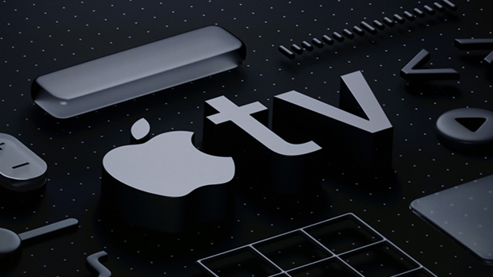
Developing For Apple TV

Slide 5

Agenda
Apple TV and tvOS
Developing for Apple TV
Demo
Notes:
For agenda today I will break my talk into 3 separate sections
First, I will briefly introduce about Apple TV and tvOS
Then, I will give you some fundamental things when working with Apple TV App
And finally, I will show you how thing works with a real demo

Slide 6
Apple TV & tvOS
Notes:
So okay. Let’s quick start with Apple TV and tvOS introduction

Slide 7
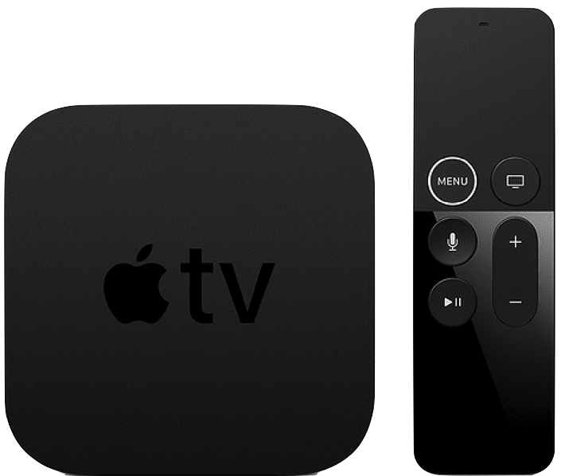
Apple TV 4K
5th Gen (2017)
Notes:
Apple TV is a digital media player device. It can collect data from internet.
And to use it for viewing, you have to connect it to a TV by a HDMI cable.
On the screen is the latest Apple TV release, Apple TV 4K, the 5th gen.
And to control Apple TV, we need to use the remote, which Apple name it Siri Remote because it has Siri Assistance.
Furthermore you also can use your iPhone to communicate with Apple TV.
This is something very awesome from Apple. Everything can be compatible perfectly
If you haven’t tried it before. we are putting some Apple TV on the back shelf.
If you are interested, you can go there give it a try

Slide 8

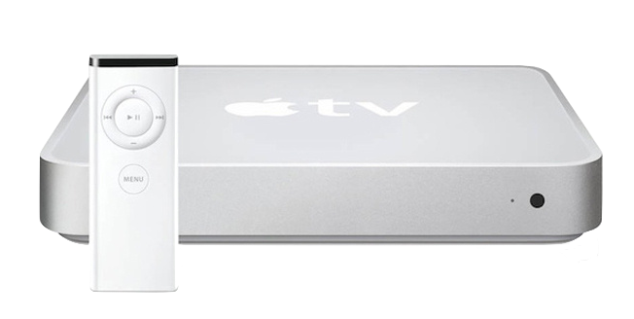
2007: iPhone 1st Gen
2006: Apple TV 1st Gen
Notes:
Even though Apple TV only has 5 models
But you know, it is older than iPhone
In 2006, Apple announce the first Apple TV with the name iTV
One year before they introduce the first iPhone which has changed the phone industry forever
And it is interesting that this Apple TV run on macOS

Slide 9
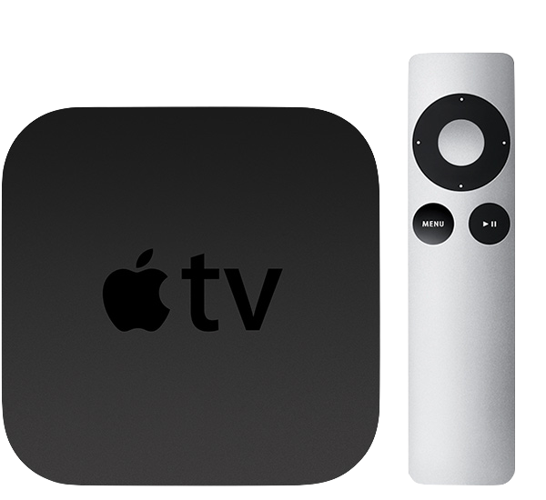
Apple TV 2nd Gen (2010)
Notes:
In middle 2010, They redesign Apple TV and make it run on iOS instead
Until end of 2010, Apple bring in tvOS 9 which is 95% bases on iOS 9
And since there, Apple TV can only run on tvOS

Slide 10
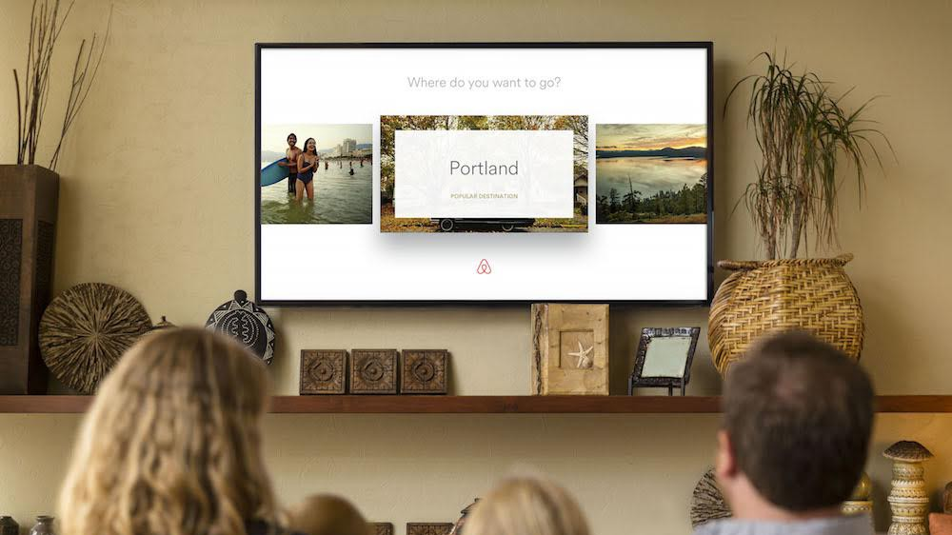
Notes:
You know, Originally I thought Apple TV is only applicable with Video and Gaming app.
In fact, there are many more kind of app on Apple TV further than that.
Do u think you can book a hotel by a TV
The answer is, yes. Airbnb has an Apple TV app

Slide 11
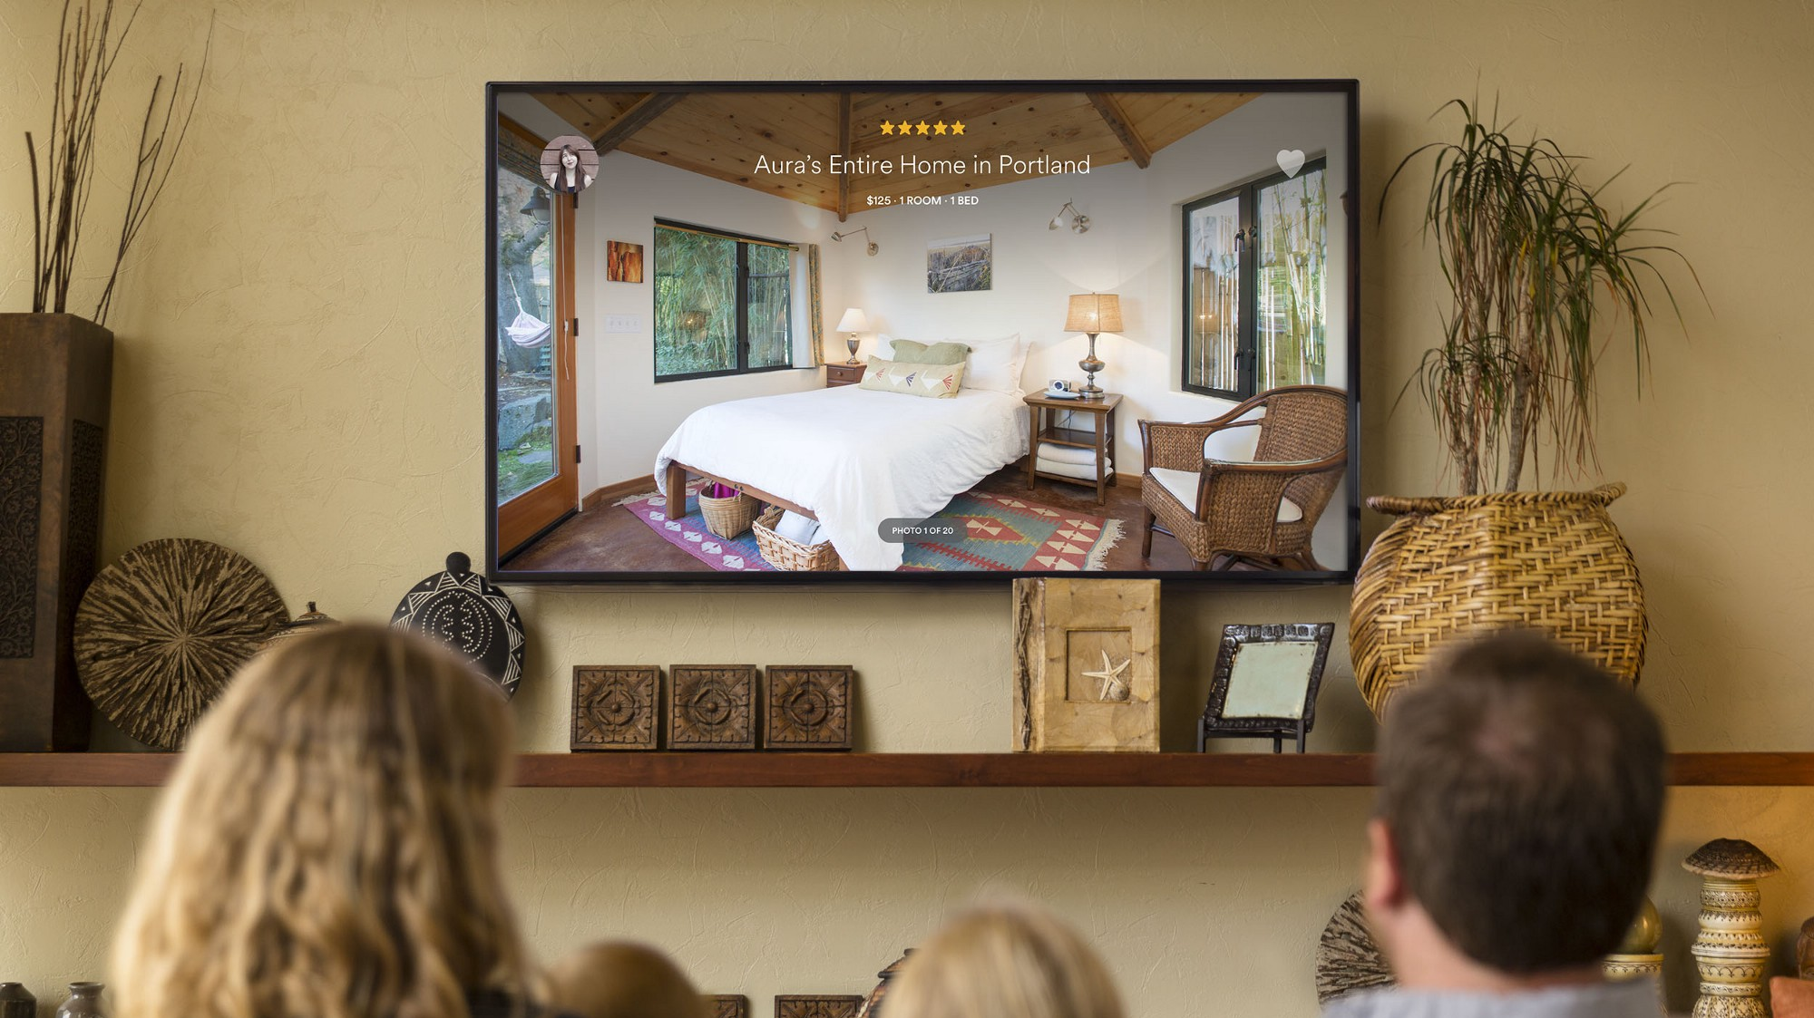
Notes:
Actually in some situations, Apple TV is a better option than iPhone,
Imaging you are planning for a vacation with your family.
Better if we can sit down can book the hotel together.
In this case, Apple TV is absolutely a better choice for the discussion because every one can see the room pictures on a shared TV.
On the other hand, the big picture is more attractive and make you more desire to book the room.
Compare with their rival which doesn’t have an app on Apple TV, they are losing this huge number of users

Slide 12
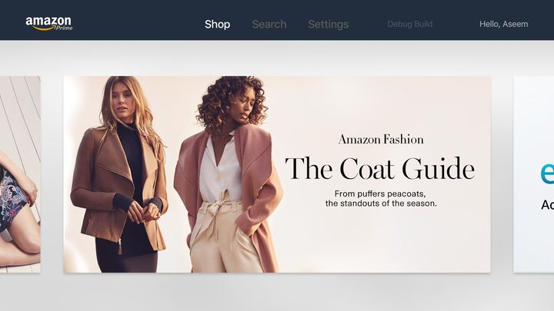
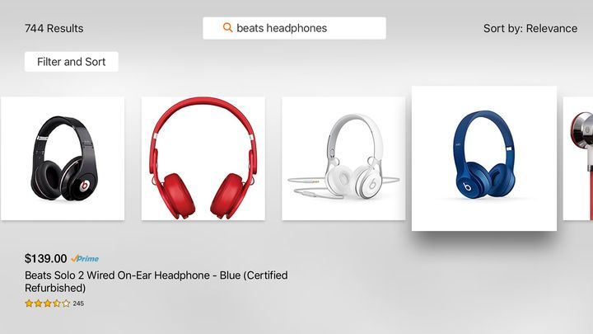

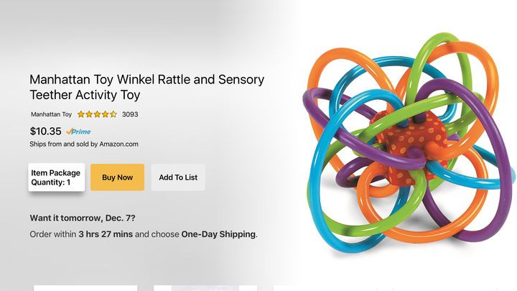
Notes:
Beside Airbnb, Amazon also allow you to shopping on Apple TV.

Slide 13

Notes:
And Tinder is another example for Apple TV app.
In my perspective creativity has no limit. As long as you intend to have an Apple TV app, you would find a way to implement it
Just keep in mind that, user who willingly spend money to buy Apple TV for entertainment is very potential to pay for your service.

Slide 14
Apple TV sold
Notes:
Here I have a chart for Apple TV turnover from 2012 to 2017. Apparently, Apple TV is growing up very fast.
In 2012, there are 4.2 millions devices has been sold.
Only three years later, the number has increased six time, to 25 million
And take another two year to reach 75 million, three times better.
Actually 75 millions is a huge number because Apple TV is not an individual device.
Usually we only have one per family.
To make you easy to imagine, Apple TV is now taking 18% of the whole world TV box market
Which make it the second largest brand in the world
It’s significant and impressive
I just emphasize it to let you know it is a potential market that you should not ignore

Slide 15
Developing for Apple TV
Notes:
I will continue with some fundamental things when working with Apple TV

Slide 16
tvOS app
Custom app
Using same frameworks with native iOS
Client – Server app
Using TVML, TVJS, TVMLKit
Notes:
There are 2 types of Apple TV app. In general, we will make them in different way.
First is the custom app which you develop it similarly when we do on iOS.
It use the same frameworks and concept that you already know.
For example Storyboards, UIKit, Auto Layout, etc
The other one is client-server app, which you need to use TVML, TVJS and TVMLKit to make it.
I will explain to you these 3 abbreviation

Slide 17
TVML
TVML (Television Markup Language) is a form of XML
Apple provides dozens of TVML premade templates
TVJS (Television JavaScript) is a set of JavaScript APIs which provide the means to display apps created by TVML
TVMLKit is a framework which will bridge the gap between native code and TVML, Javascript code.
Notes:
Apple provides dozens of TVML premade templates which can help you easily display information in a specific way.
In a Few slides later I will show you some example of a TVML template
TVMLKit a framework that make you be able to communicate between TVML, JavaScript, and your native tvOS app

Slide 18
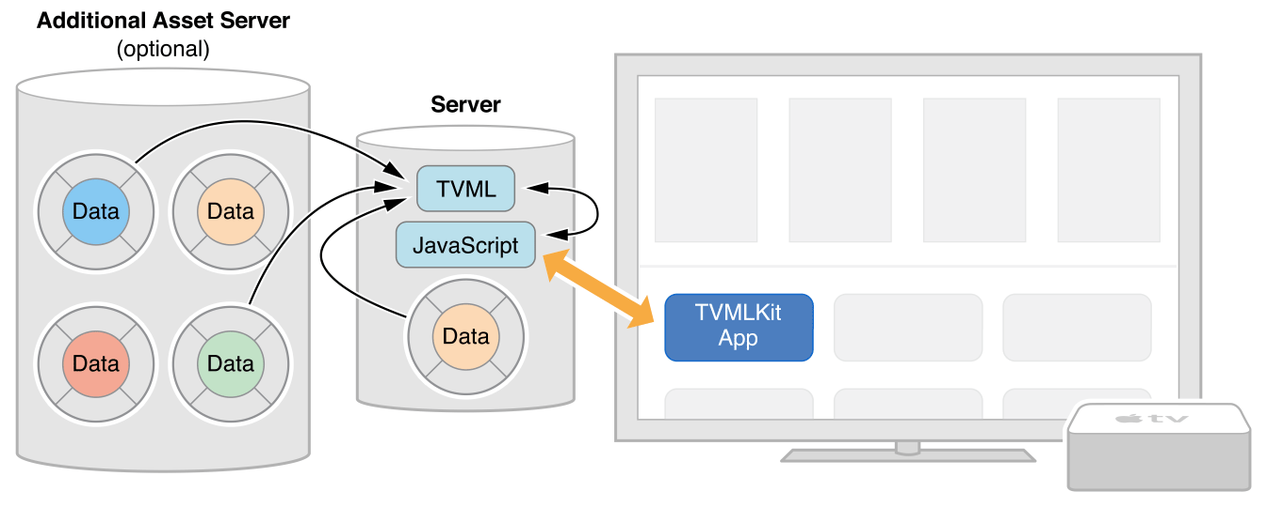
HOW DOES IT WORK?
Notes:
In short, for custom app, we just archive UI and logic code in the execution binary file.
Whereas, TVML app has different concept
Our app is here, and we will put UI and logic code in a remote sever here.
We only declare the URL to that server in AppDelegate, and hence when the app launch, we will fetch the source code and lean on it to run the app.
Similarly with custom app, It may need to call other APIs to get data from server when user using the app

Slide 19
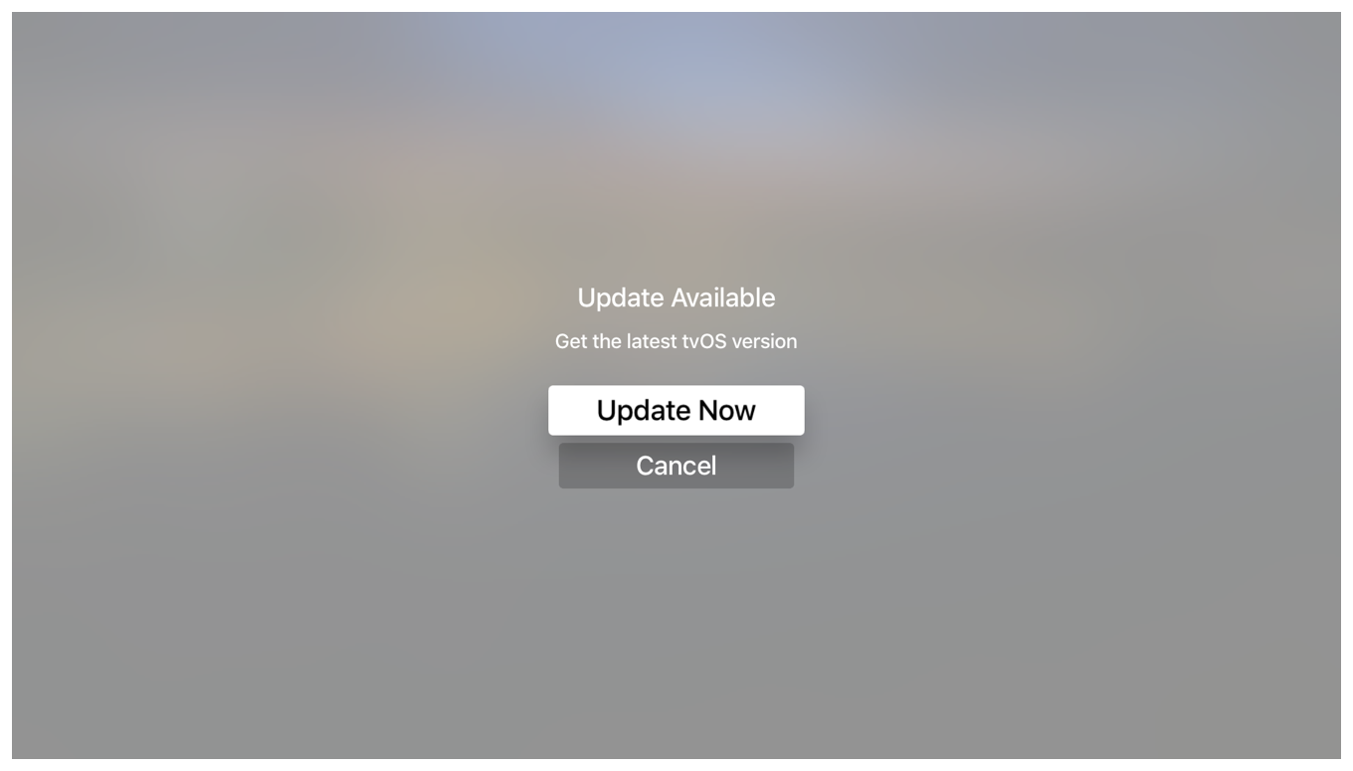
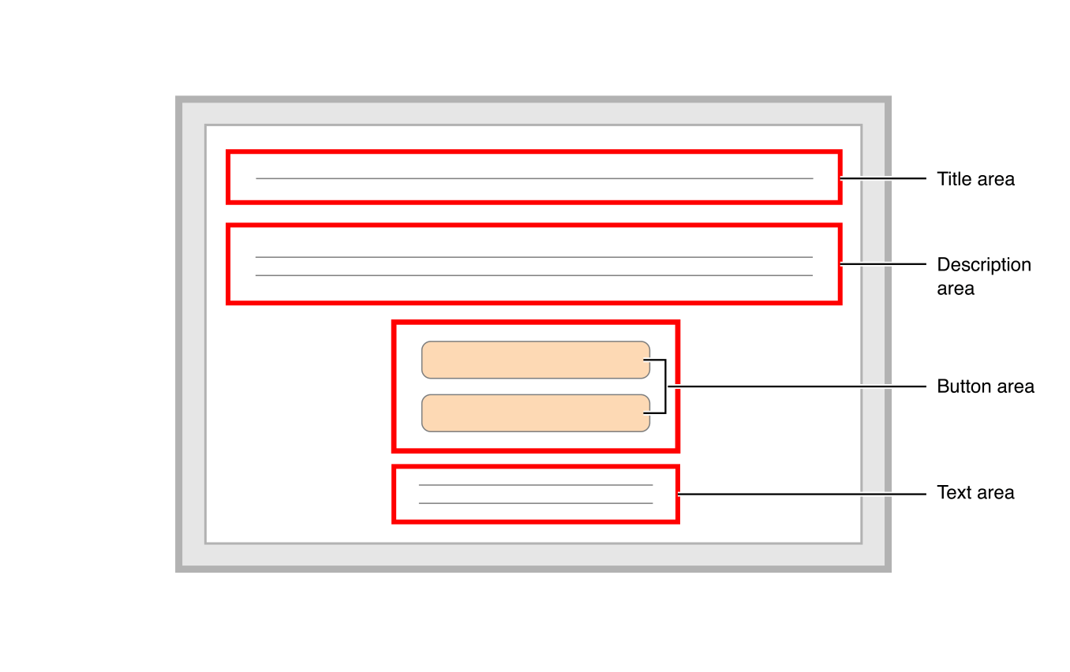
TVML Template Example
Notes:
We will continue with some TVML premade template example.
So I will start with a simple one first
On your left hand side is the alert view on Apple TV
On your right hand side is the premade template diagram
It’s not so hard to link each element from the diagram to the view
For instance, Title area will be the first line, and follow by description, and buttons, etc

Slide 20
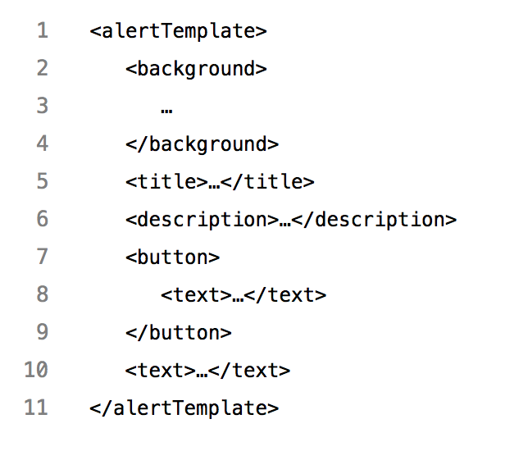
TVML Template Example
Notes:
And this is is how the template code look like
If you know any markup language such as XML, HTML before you would be familiar to this format
Here I have the biggest field is alertTemplate, it has some properties, like background, title, description, etc.
They represent for the element on the diagram

Slide 21
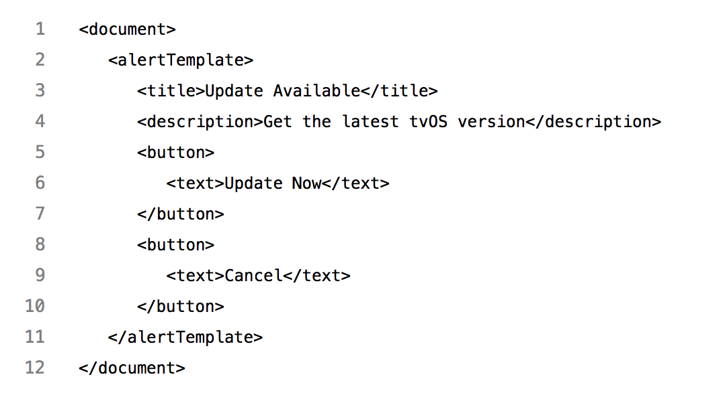
TVML Template Example
Notes:
And finally after filling data to the template you will get the view as expectation
For example here i put "Update available" for title field,
"Get the latest tvOS version" for description field, …
Then when the app run, it can convert from template to the native view on the screen
I just wanna highlight, It is not a web view, but a native components
This is a very simple one.
But as i mention above, there are a lot of premade templates from Apple.

Slide 22
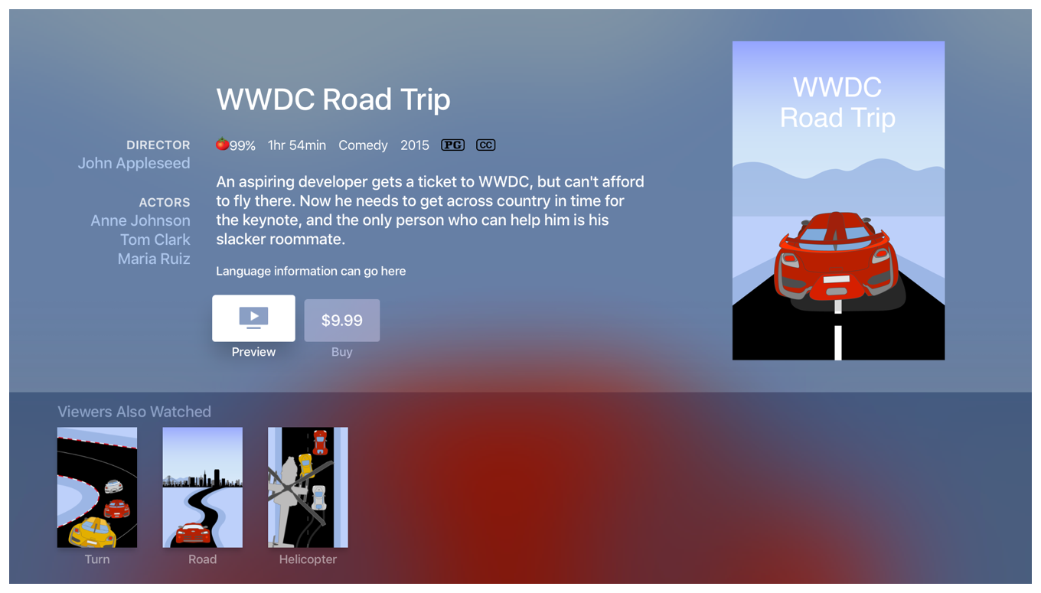
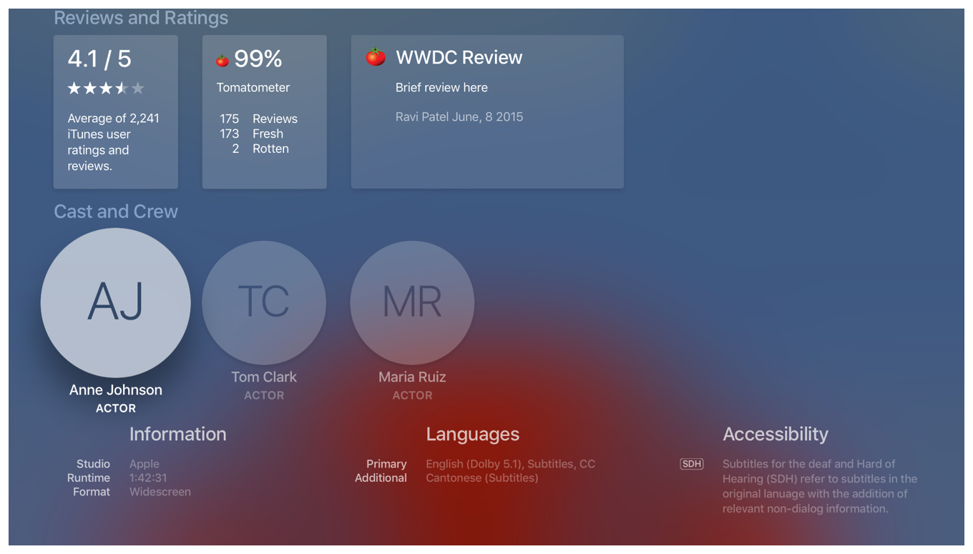
TVML Complicated Template
Notes:
Let’s look at this.
This is a long page and I slip it into 2 images
The left one is the front, and the right one is the back
It has a very complicated layout and imagine how much it will cost you to implement on custom app
You will need to care about a lot of layout constraints, collectionview data source, and the shadow and blur background here you also need to handle it thoroughly
On the other hand, TVML has a template for this page

Slide 23
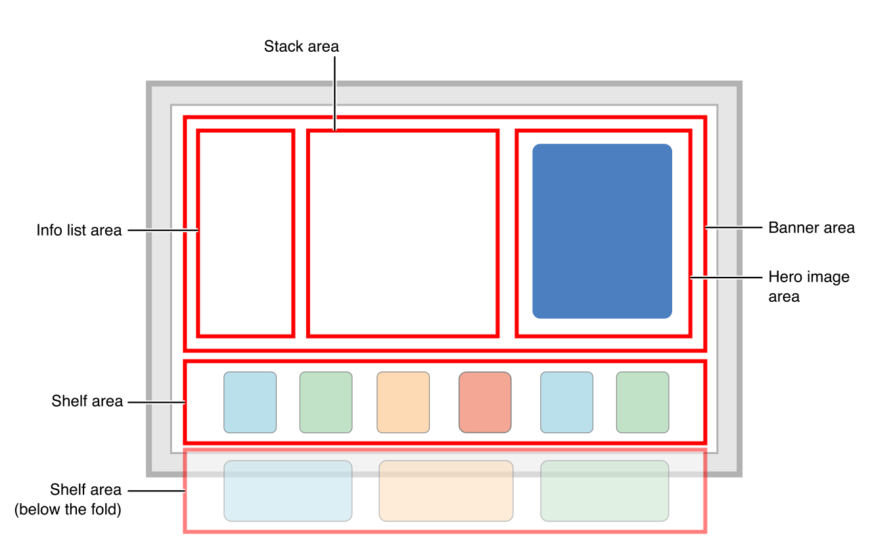
Notes:
And this is how it look like. Very specific and easy to understand
Like here is the banner area, within it will have Info list, stack view and an image.
Following by some shelf area

Slide 24
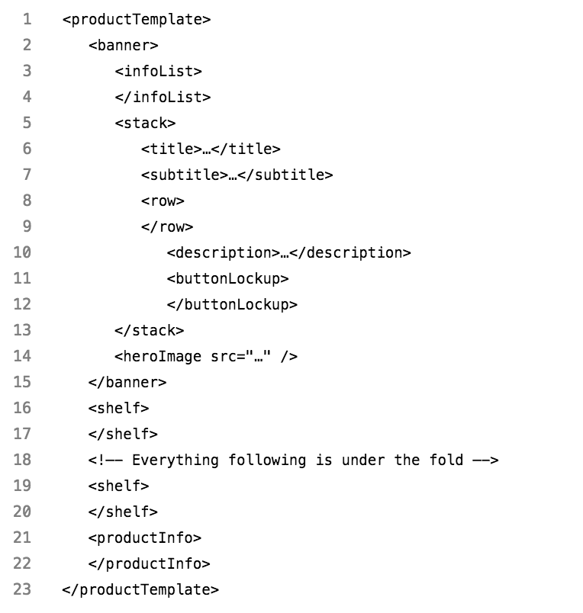
TVML Complicated Template
Notes:
So here is the template code
You can easily map it with the diagram
We can base on the template to key in our data we wanna display, and TVJS will generate the view for you automatically.
Very simple, and save you lots of time
You can find more on Apple documentations page

Slide 25
COMPARISON
Custom App | TVML App
Same way with iOS native app | TVML, TVJS, TVMLKit
Swift, Objective-C | JavaScript
More effort but scalable | Less effort but not scalable
Suitable with customizing layout | Suitable with Apple template layout
Notes:
So I make a comparison between working on custom app versus on TVML app
We develop custom app by the same way we do on iOS, meanwhile on TVML we use TVML, …
The main language we use when working with custom app is Swift and objective c, whereas on TVML it will be JavaScript
The custom app will take you more effort for creating, but it is scalable in long term and this could be your choice if your app has customizing design,
On the other hand creating TVML app cost you less effort at the beginning, but it is not scalable and only appropriate with the app has similar design with Apple template layout
So depends on your purpose you can find a most suitable way to build your tvOS app.
But for us here in Viki, we have implemented our Apple TV app in both ways. With our experience, I would recommend you to make a custom app instead. Because
First We already have an iOS project which has a lot of same feature with Apple TV app
By using custom app we can reuse a lot of logic code, and it make us can maintain and scale both app together
This is what every business want to have. We want our app is testable, maintainable, scalable
Second, it will take you a lot of time to ramp up with TVML because it’s a new concept.
And for those who have not work with JavaScript before, it will be more time consuming to get used to it.

Slide 26

vs
Notes:
Honestly, I am much more comfortable to work on Swift than on JavaScript
On Swift and ObjC you can use break point when debugging and Fabric for tracking crash.
On JavaScript you don’t have it, all of the crash from TVML will just come through App Delegate, not easy for us to fix the crash

Slide 27
Developing Custom Apple TV App On iOS Project
Notes:
Therefore I will continue with developing custom app on an iOS project

Slide 28
Project structure
UI
View, ViewController
Business Logic
API Service, Deep Link, Analytics, etc
Third Party Libraries
Install from CocoaPods, Carthage or import Framework directly
Core Framework
Foundation, UIKit, CoreData, etc
Notes:
Basically, we always be able to split our iOS project into 4 different layers
At the bottom is the Core Framework Layer. It contains some general and fundamental frameworks, such as UIKit, CoreData, CoreLocation, etc.
Hence we may need to use some 3rd Party Libraries which is built on top of Core Framework for more specific purpose.
You can install them from Cocoa Pod, Carthage, or download and add the framework sdk directly
These two first layers are very basic and they are the ingredient for us to make our app
The next layer is Business Logic Layer.
This layer will receive data (either from a remote server or from cache) then transform from the raw data to a set of information before using them to display to user
It contains some services such as API Service, Payment Service, or Location Service
And some other utilities, like Deep Link handler or Analytics logger
In reality, you can divide this layer to some smaller layers. It’s up to the design pattern you choose
But generally this layer is for nonUI code
The top one is UI Layer.
It is responsible to receive user interaction, then will send them to Business Logic Layer.
After receiving the information from Business Logic Layer, it will determine what to response back to user
Our object is to build an Apple TV app with the least cost. Assuming we already have an iOS app, so we will avoid repeating the code but reuse them as much as possible. Look at the diagram again and see what we can take advantage on tvOS

Slide 29
Reusability
UI
Very little, Only for base classes
Business Logic
All of the logic code for the same feature should be shared
Third Party Libraries
Most of the 3rd Party Libraries on iOS are available on tvOS
Including RxSwift, Alamofire, SwiftyJSON, Crashlytics, etc
Core Framework
Most of the core frameworks on iOS are available on tvOS
BiometricKit, WebKit on iOS <> TVUIKit, TVServices on tvOS
Notes:
Core Framework
Because tvOS is very close to iOS hence most of the core frameworks on iOS are also available on tvOS, like Foundation, UIKit
Even though still have some frameworks only support for a particular platform. For example,
BiometricKit is not on tvOS, because Apple TV does not have TouchId or FaceId. Hopefully they can integrate it to Siri Remote in a near future
WebKit is another one not on tvOS because Apple TV does not use WebView for displaying.
In contrast, TVUIKit and TVSerives are not applicable for iOS. They contains some UI elements and services which only for Apple TV.
Third Party Libraries
Because they is built on top of Core Framework. Therefore, as long as the library only use the framework support for tvOS, it’s supposed to be applicable on tvOS also.
Since most of the Core Frameworks on iOS are available on tvOS
Hence most of the 3rd party libs on iOS are useful on tvOS as well
If you are a fan of reactive programming, don’t worry, because RxSwift is applicable for tvOS
Besides we also have Alamofire, AFNetworking, SwiftyJSON, and many other awesome libraries on tvOS
Business Logic
When we plan to implement a feature, we always want to support for both platforms, as long as the device is fitting with the feature. This is how we scale the business.
Ideally all logic code for these features must be shared together. It means if we already implemented them on iOS, we can just reuse them, instead of repeating it one more time for tvOS.
UI
Because of the difference between iOS devices and Apple TV, the layout on iOS and tvOS are not alike. Hence we will not reuse much UI code. We may only need to share some UI Class extension, like UILabel extension or UIButton extension, …
So to summarize, as long as we separate UI code and Logic code, we don’t need to do many things to have Apple TV app.
Morever, Isolating Logic code to UI code not only make your project more organized but also make it more testable. So I really encourage you to split them out.
I have talk about it too much. Let’s start with a Demo. I will show you in reality.

Slide 30
Demo

Slide 31
Q&A

Slide 32
Thanks for your attention

